Slide 1
DENGUE DISEASE DETECTION
JNTUA College of Engineering,Pulivendula
CSE Department
Project Guide: T.Niranjan Babu
BY
B.Hari Chandana
Patil Lakshminarayanamma
Sana Babu Reddy

Slide 2
CONTENTS
Introduction
Need for study
Literature survey
Problem statement
Technologies used
Dataset Description
Architecture
Data cleaning
Data Visualization and Heat Map Generation
Performing Predictions
Conclusion

Slide 3
INTRODUCTION
Dengue fever is a mosquito-borne disease caused by the dengue virus.
It is a life-threatening disease lots of people died due to dengue.
The challenge is to collect huge volumes of data.
Healthcare can be made smart by using ML in health field.

Slide 4
NEED FOR STUDY
National Vector Borne Disease Control Programme displayed DENGUE SITUATION IN INDIA.
Reference link: https://nvbdcp.gov.in/index4.php?lang=1&level=0&linkid=431&lid=3715
Bihar man blames doctors for dengue deaths
Article Link: https://gulfnews.com/world/asia/india/bihar-man-blames-doctors-for-dengue-deaths-1.67284927
Adya Singh’s dengue death case: Fortis hospital doctor booked
Article Link: https://timesofindia.indiatimes.com/city/gurgaon/adya-singhs-dengue-death-case-fortis-hospital-doctor-booked/articleshow/62014634.cms

Slide 5
Literature survey
Automated Dengue Detection
https://irjet.net/archives/V5/i6/IRJET-V5I689.pdf
Early Detection of Dengue Using Machine Learning Algorithms
https://acadpubl.eu/jsi/2018-118-18/articles/18d/79.pdf

Slide 6
Problem statement
There is a existing system for dengue detection based on weather forecasting but we design a problem with the help of hospital data to predict dengue disease.

Slide 7
TECHNOLOGIES USED
Machine Learning Algorithms
Random Forest
Decision Tree
To Implement User interface we are using
Django framework
HTML

Slide 8

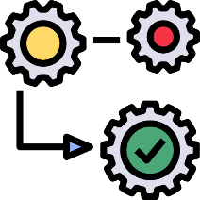









ARCHITECTURE
Collecting Data
Pre-Processing
Data Set
Train the Machine Learning Algorithm
Evaluate
Prediction Model
Input Data
Machine Learning Algorithm
Prediction

Slide 9
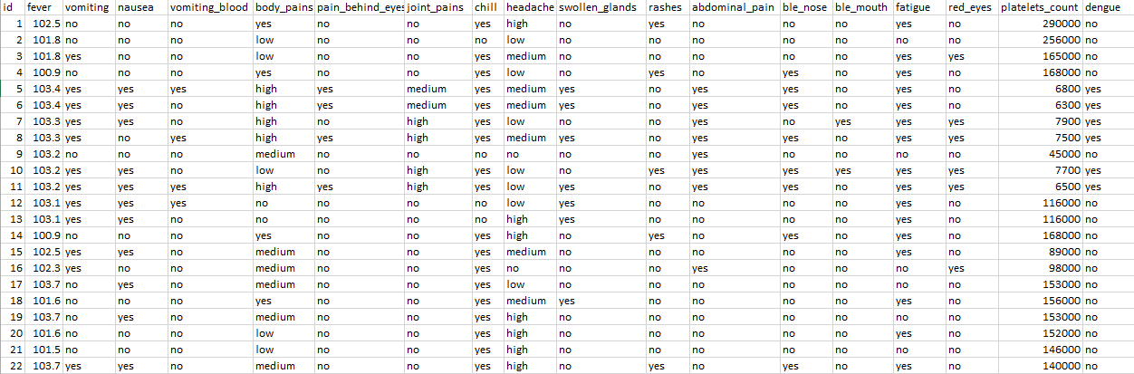
Dataset Description

Slide 10

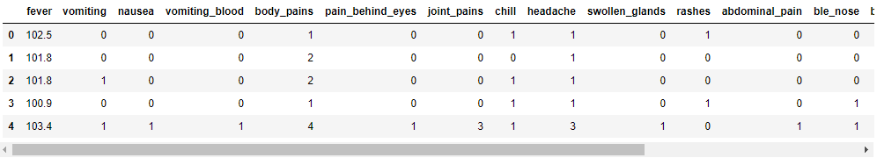
Data Cleaning

Slide 11
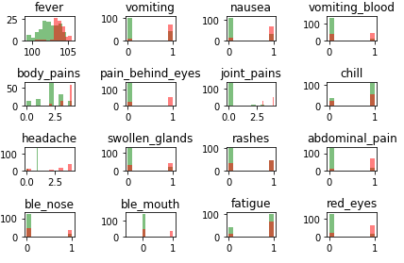
Data Visualization

Slide 12
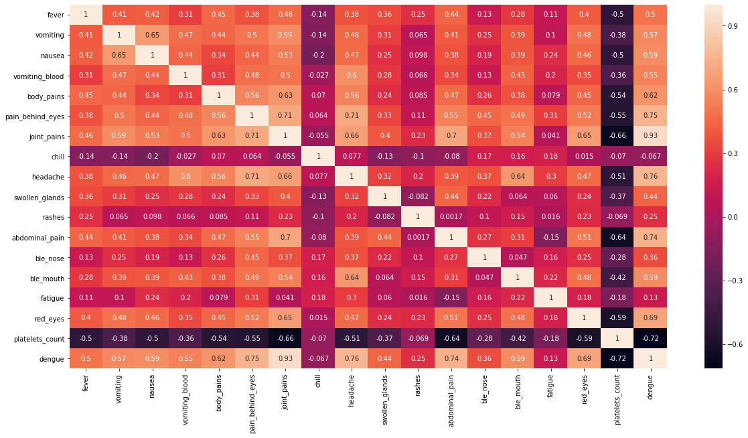
Heat Map Generation

Slide 13
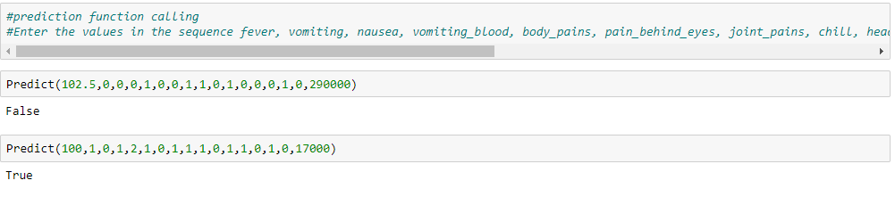
Performing Predictions

Slide 14
Conclusion
To Propose a dengue disease prediction system for hospital.

Slide 15
THANK YOU

